Slide 1
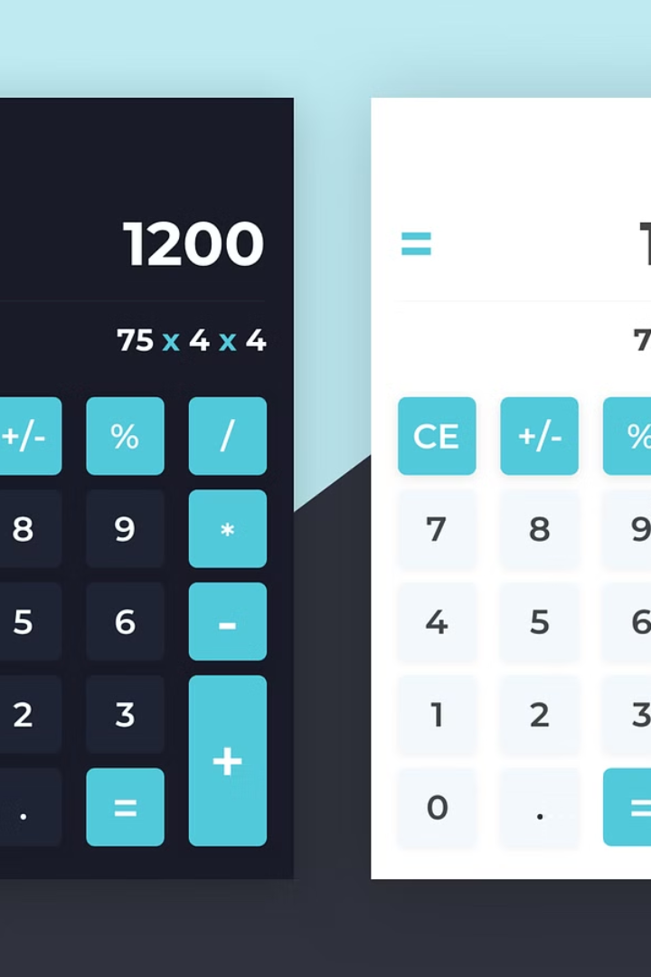
Building a Basic Calculator GUI in Python Using PyQt
Welcome to this presentation, where we'll explore the creation of a simple calculator GUI using PyQt, a Python toolkit for developing graphical user interfaces. We'll start with a basic understanding of PyQt and dive into the advantages of using it for GUI development. This session is designed to equip you with the knowledge and skills to design and build a functional calculator application.

Slide 2
Introduction to PyQt
PyQt: A Powerful Tool for GUI Development
Features of PyQt
PyQt is a cross-platform GUI toolkit, a set of tools and libraries designed to create graphical user interfaces (GUIs) for software applications. It's written in Python, making it easier for Python developers to create visually appealing and user-friendly applications. PyQt is based on the Qt framework, developed by The Qt Company.
PyQt is well-known for its powerful features, including: • Rich set of widgets: Buttons, labels, text fields, drop-down menus, etc. • Signal and slot mechanism: Enables seamless event handling. • Style sheets: Allows for customization of the look and feel of the GUI. • Cross-platform compatibility: Works seamlessly on Windows, macOS, Linux, and other operating systems.

Slide 3

The Power of PyQt for a Calculator GUI
1
Intuitive and Interactive User Experience
2
Event Handling for User Interactions
PyQt offers a range of widgets perfectly suited for designing a calculator, such as buttons for numbers and operations, display fields for input and output, and layouts to arrange these elements effectively.
PyQt's signal and slot mechanism allows you to handle user interactions, like button clicks, in a structured and efficient manner, ensuring seamless functionality for your calculator.
3
Customizable Styling and Layout
PyQt's CSS-like style sheets enable customization of the calculator's appearance, allowing you to match your application's design with your desired aesthetic.

Slide 4

Why Use PyQt for a Calculator GUI?
Ease of Use
Flexibility and Extensibility
PyQt's intuitive design and comprehensive documentation make it a user-friendly framework, even for beginners. The clear structure and well-defined classes simplify the process of building your calculator GUI.
PyQt offers a wide array of widgets and customization options, allowing you to build a basic calculator and easily extend it with advanced features like scientific functions, memory storage, and more.
Community Support
PyQt enjoys a strong and active community, providing access to extensive documentation, tutorials, and helpful resources online. This support network can be invaluable for troubleshooting any issues you might encounter during development.

Slide 5
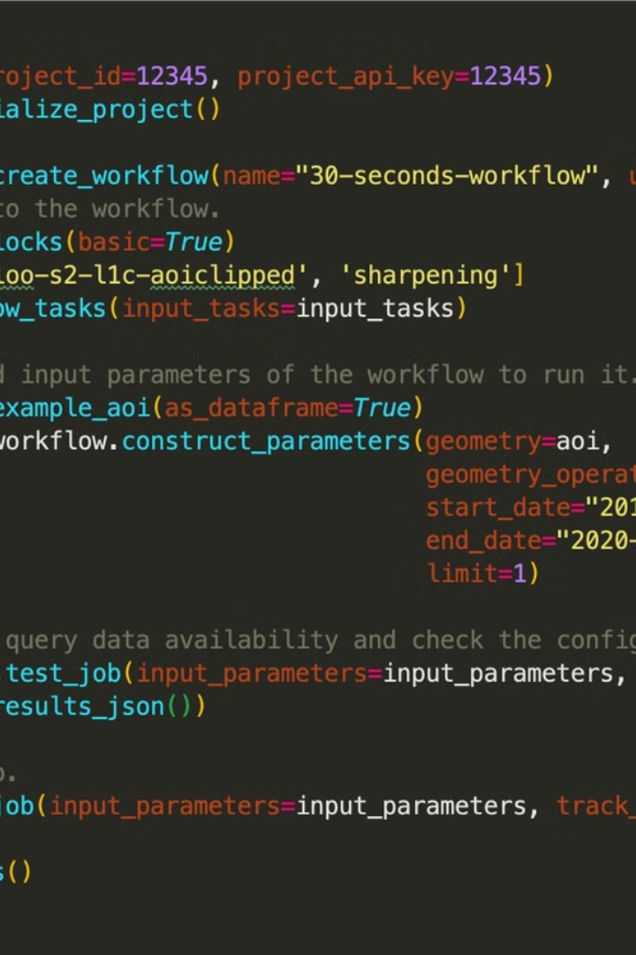



Skills and Tools Required
Python Programming Fundamentals
A basic understanding of Python syntax, variables, data types, operators, control flow, and functions is essential.
GUI Design Principles
Familiarity with GUI design concepts, including layout, user flow, and accessibility, is beneficial for creating a user-friendly calculator.
PyQt Knowledge
While not required beforehand, a basic understanding of PyQt's core concepts like widgets, layouts, signals, and slots will expedite your development process.

Slide 6
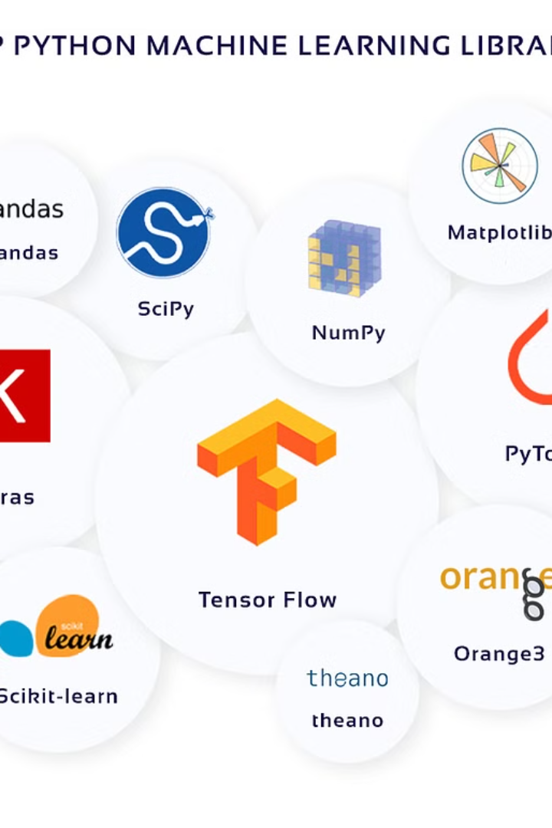
Key Python Libraries
1
PyQt: The core library for creating the calculator GUI. It provides the widgets, layouts, event handling mechanisms, and styling options necessary for building the application.
2
sys: This library allows you to access system-specific parameters and functions, which are needed for interacting with the command line environment.
3
QtCore: A foundational PyQt module containing classes for object management, signals and slots, timers, and other essential features. It is the basis for building your application's structure.

Slide 7





Development Workflow
1. Install PyQt Library
To begin, install the PyQt library using pip, the Python package installer. Open your terminal or command prompt and type: pip install PyQt5
2. Create the GUI Structure
Build the basic layout of your calculator using PyQt widgets such as QApplication, QWidget, QLabel, QLineEdit, and QPushButton. Arrange these widgets using layouts like QGridLayout, QHBoxLayout, or QVBoxLayout.
3. Implement Button Click Functionality
Connect signals to slots. For example, connect the clicked signals of each number button to a function that updates the display. Connect the signals for operations to functions that perform the calculations.
4. Add Calculations Logic
Implement the core calculation logic using Python's mathematical operators. Handle arithmetic operations, clear the display, and perform other functions as needed.
5. Test and Refine
Run your calculator GUI and test its functionality. Ensure that all buttons work correctly, calculations are accurate, and the display updates properly.

Slide 8





Sources and Tools Used
1
PyQt Documentation
2
Online Tutorials and Articles
3
PyQt Example Projects
4
Stack Overflow
5
Python IDE (e.g., PyCharm)

Slide 9
Conclusion and Next Steps
Key Takeaways
1
Creating a calculator GUI using PyQt is a rewarding experience, demonstrating the power of this GUI toolkit for building interactive applications. It lays the foundation for exploring more complex GUI projects.
Enhancements
2
Add features like scientific operations, memory functions, and custom themes. Explore the full potential of PyQt by incorporating more advanced widgets and layouts.
Explore Advanced GUI Development
3
Use PyQt for more intricate GUI applications like data visualization tools, graphical editors, or even full-fledged desktop software.

